Slide 1
Slides for Smallmouth Bass Taxonomy and Genetic Diversity
Joe Gunn

Slide 2
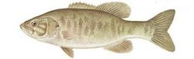
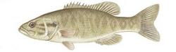
Neosho vs. Northern Smallmouth Bass
Northern Smallmouth Bass
14 soft dorsal rays
Bulky, more rotund predorsal contour
Non-protruding lower mandible
No teeth along the tongue
Dark, slender, elevated bars
Neosho Smallmouth Bass
13 soft dorsal rays
Straight, slender predorsal contour
Protruding lower mandible
Developed teeth along the tongue
Dark, broad, less elevated bars
14 soft rays
13 soft rays
Hubbs and Bailey, 1940

Slide 3
Genetic Distinction and Diversity
Morphology and ecology suggest genetic distinction
Stark and Echelle (1998) reveal 3 potential clades
Neosho (blue)
Northern (green)
Ouachita (red)
High smallmouth diversity in Interior Highlands
Neosho SMB
Stark and Echelle, 1998

Slide 4
Neosho Smallmouth Bass Genetic Diversity
Within NSMB
Ave. F_{st} = 0.051
Between Subspecies
Ave. F_{st} = 0.089
Within Northern
Ave. F_{st} = 0.028

